Slide 1

HEALTH GUARD
"Harnessing the Power of Machine Learning for Early Detection and Personalized Recommendations"

Slide 2
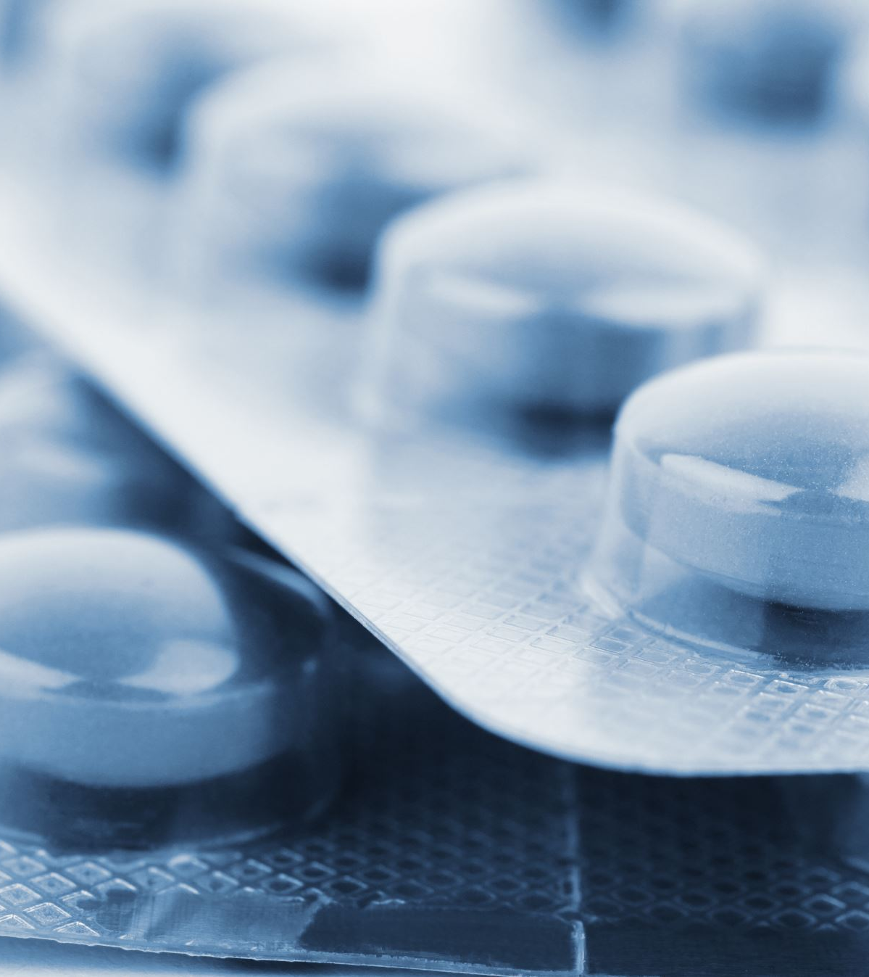
PROBLEM STATEMENT :
Early Detection of health issues and predicting whether the patient/user has a particular disease based on some data about his/her health report.

Slide 3
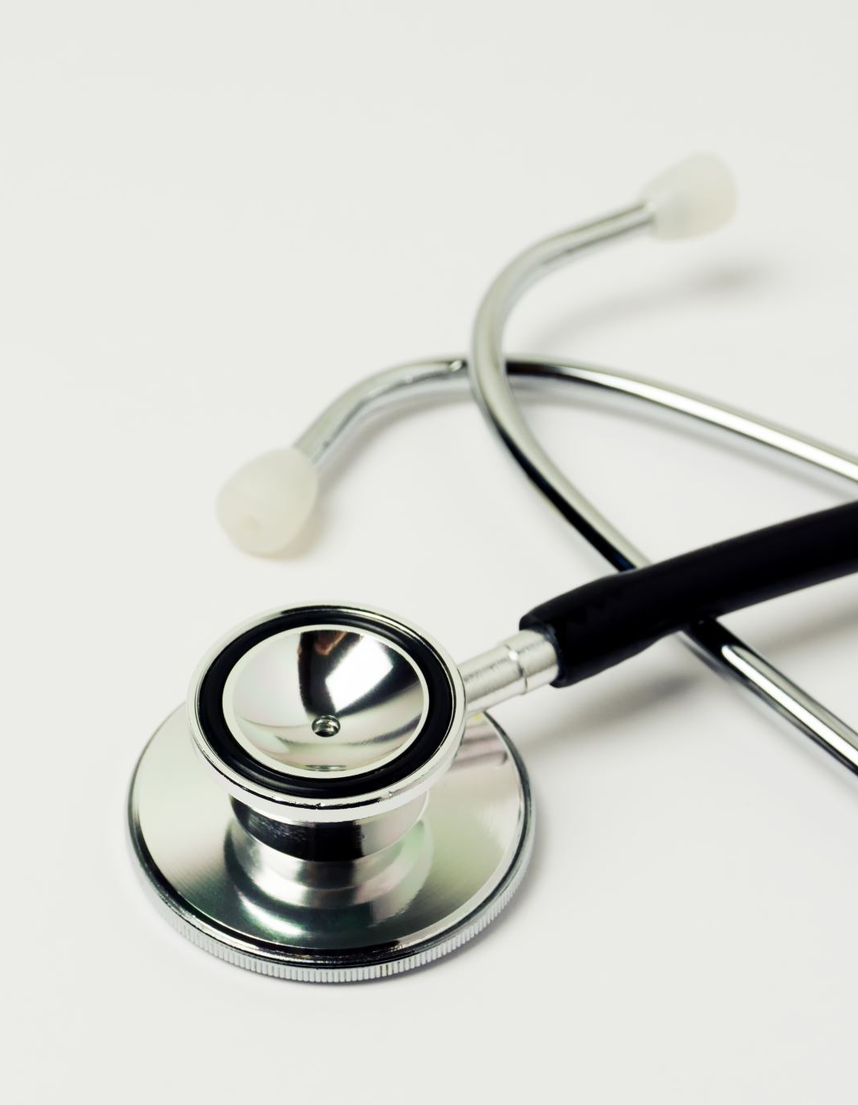
SOLUTION :
We are developing a machine learning model which will help to predict whether the patient/user has a particular disease based on his/her health report.
Our main focused diseases are :
COVID
DIABETES
HEART DISEASE

Slide 4

TECHNOLOGIES USED :
Google Colab
Python
Model : Supervised Learning Model
Dataset : from Kaggel website
Web Technologies: HTML CSS JAVASCRIPT
NODEJS EXPRESS AND CHILD PROCESS
Python Libraries :
Numpy
Pandas
Sklearn
Pickle

Slide 5
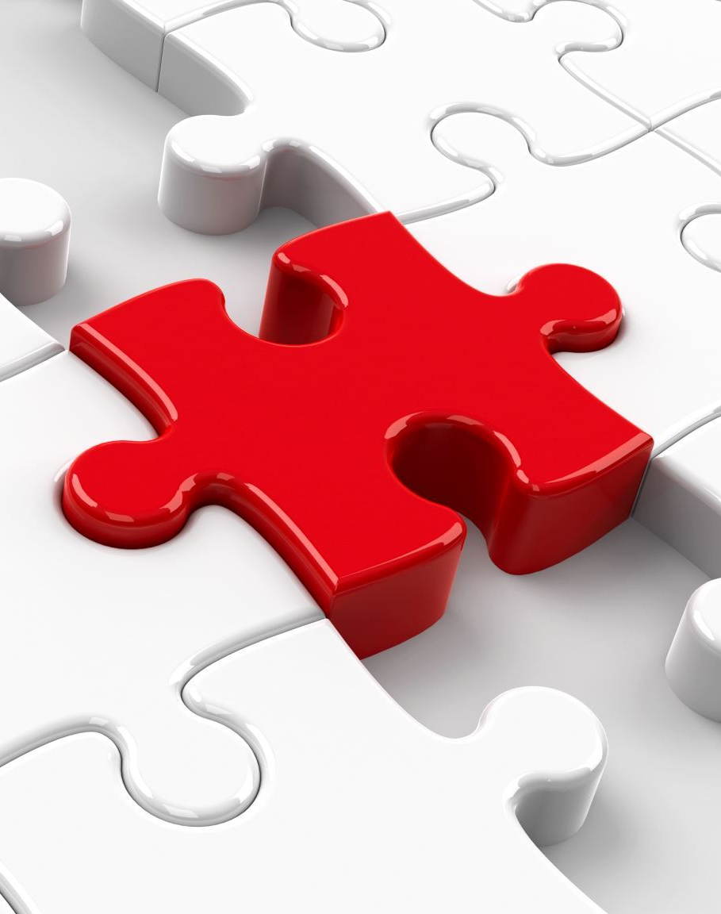
SOLUTION APPROACH :
Downloaded Dataset:
Obtain relevant health data from trusted sources.
Ensure the dataset includes diverse health parameters and sufficient sample size.
Data Preprocessing:
Clean the dataset to handle missing values, outliers, and inconsistencies.
Perform data transformation tasks like encoding categorical variables and feature selection to enhance model performance

Slide 6

SOLUTION APPROACH :
3.Data Standardization:
Normalize or scale the features to ensure uniformity and comparability across different data points.
Standardization helps in improving the convergence speed of machine learning algorithms.

Slide 7

SOLUTION APPROACH :
4.Training the Supervised Model:
Utilize machine learning algorithms like logistic regression, decision trees, or neural networks.
Train the model using the preprocessed dataset to learn patterns and relationships between health parameters and potential health issues.

Slide 8

SOLUTION APPROACH :
5.Evaluation:
Assess the model's performance using appropriate evaluation metrics such as accuracy, precision, recall, and F1-score.
Validate the model's effectiveness through cross-validation techniques to ensure robustness and generalizability.

Slide 9
THANK YOU
LETS START WITH PROJECT DEMO

